Slide 1
AME20216 - Lab I L11 - Digital Electronics

Slide 2
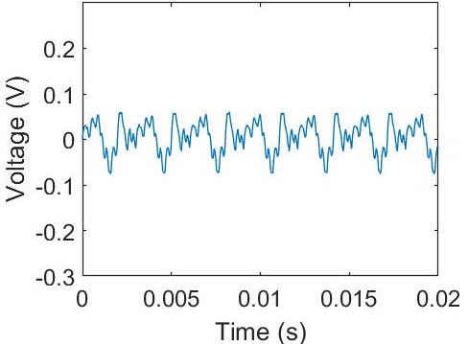
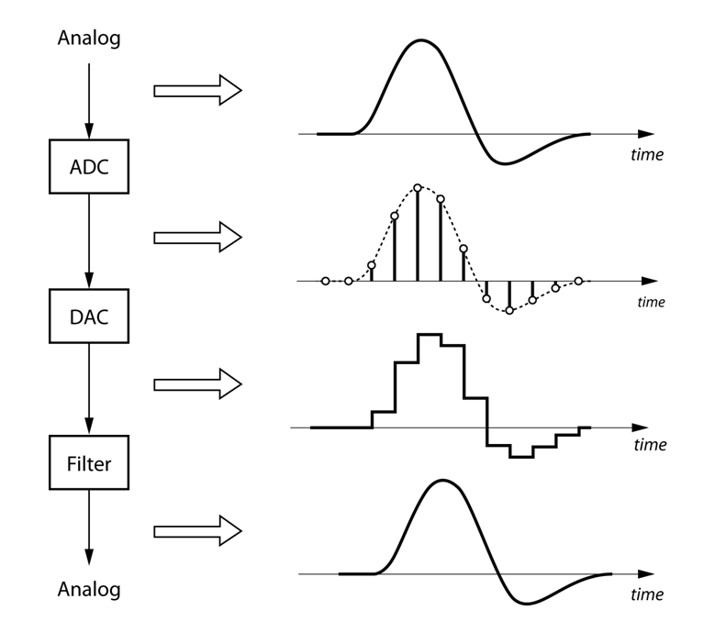
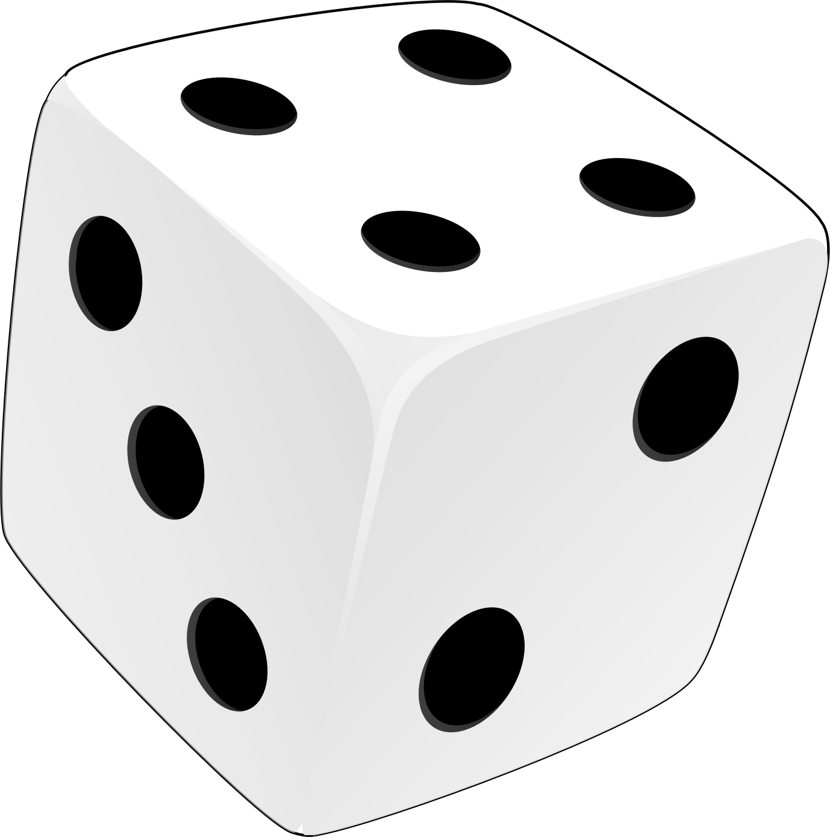
Moving Forward
Transient Signals – Measuring and analyzing a signal vs. time (A9 and A10)
Probability and Statistics – Analyzing data and complex systems (HW4)

Slide 3
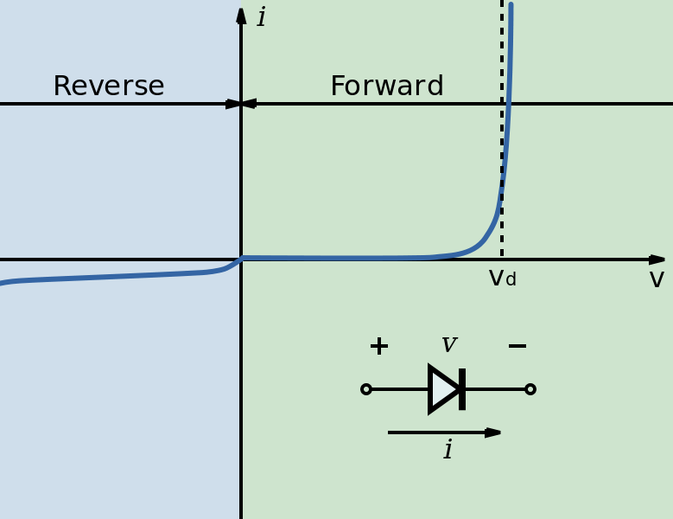
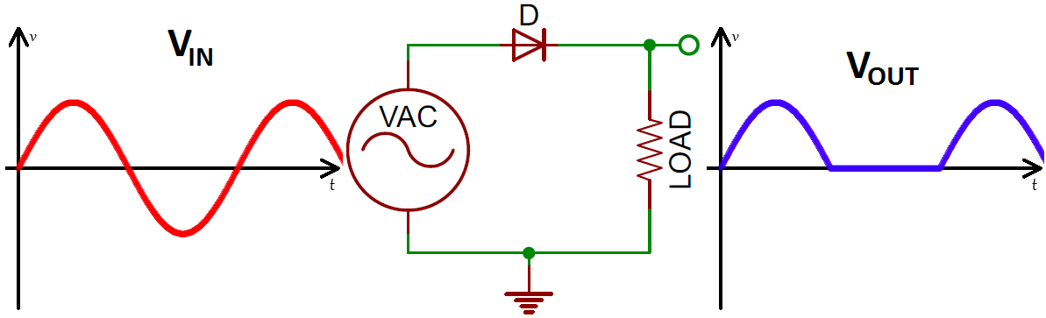
Diodes
A diode is a semiconductor device that only allows current to flow in one direction.
Rectification

Slide 4
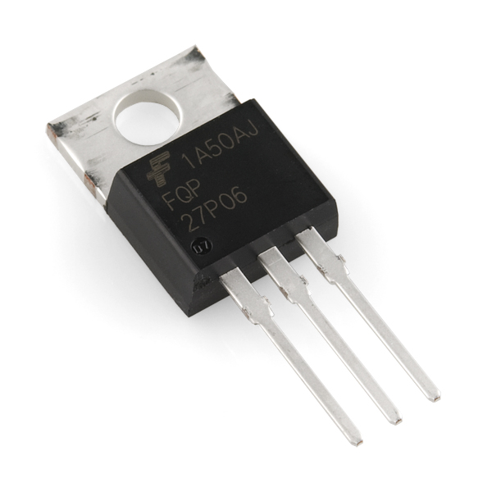
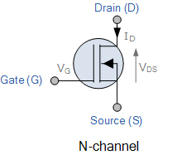

Transistors
Used for Amplifiers and Logic Circuits
MOSFET
BJT
www.en.wikichip.org

Slide 5
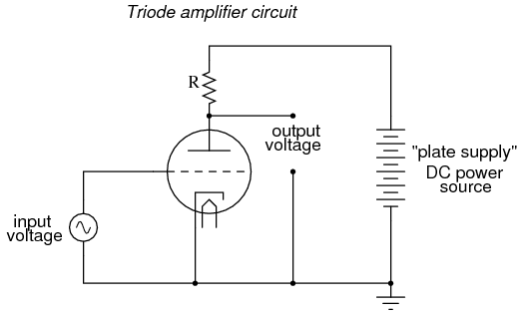
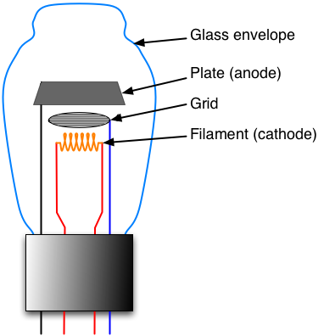
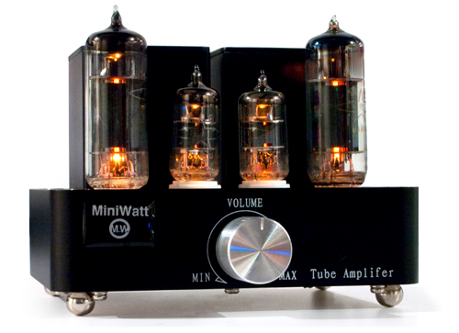
Vacuum Tube Amplifiers

Slide 6

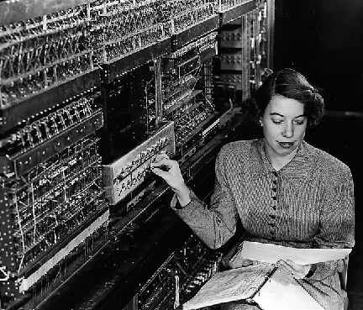
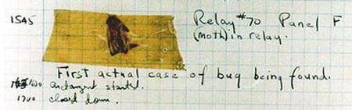
Electronic Numerical Integrator And Computer (ENIAC)
Built by the US Army in 1946.
17,468 vacuum tubes!
Computer programs used to actually contain bugs!
https://en.wikipedia.org/wiki/ENIAC

Slide 7
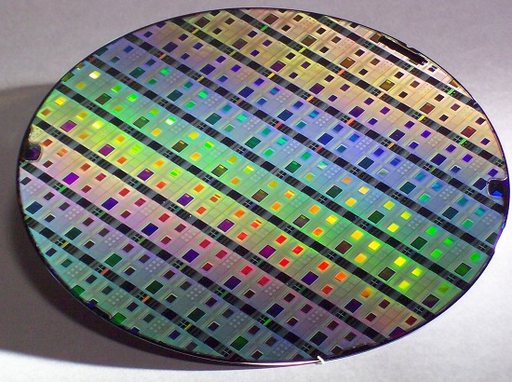
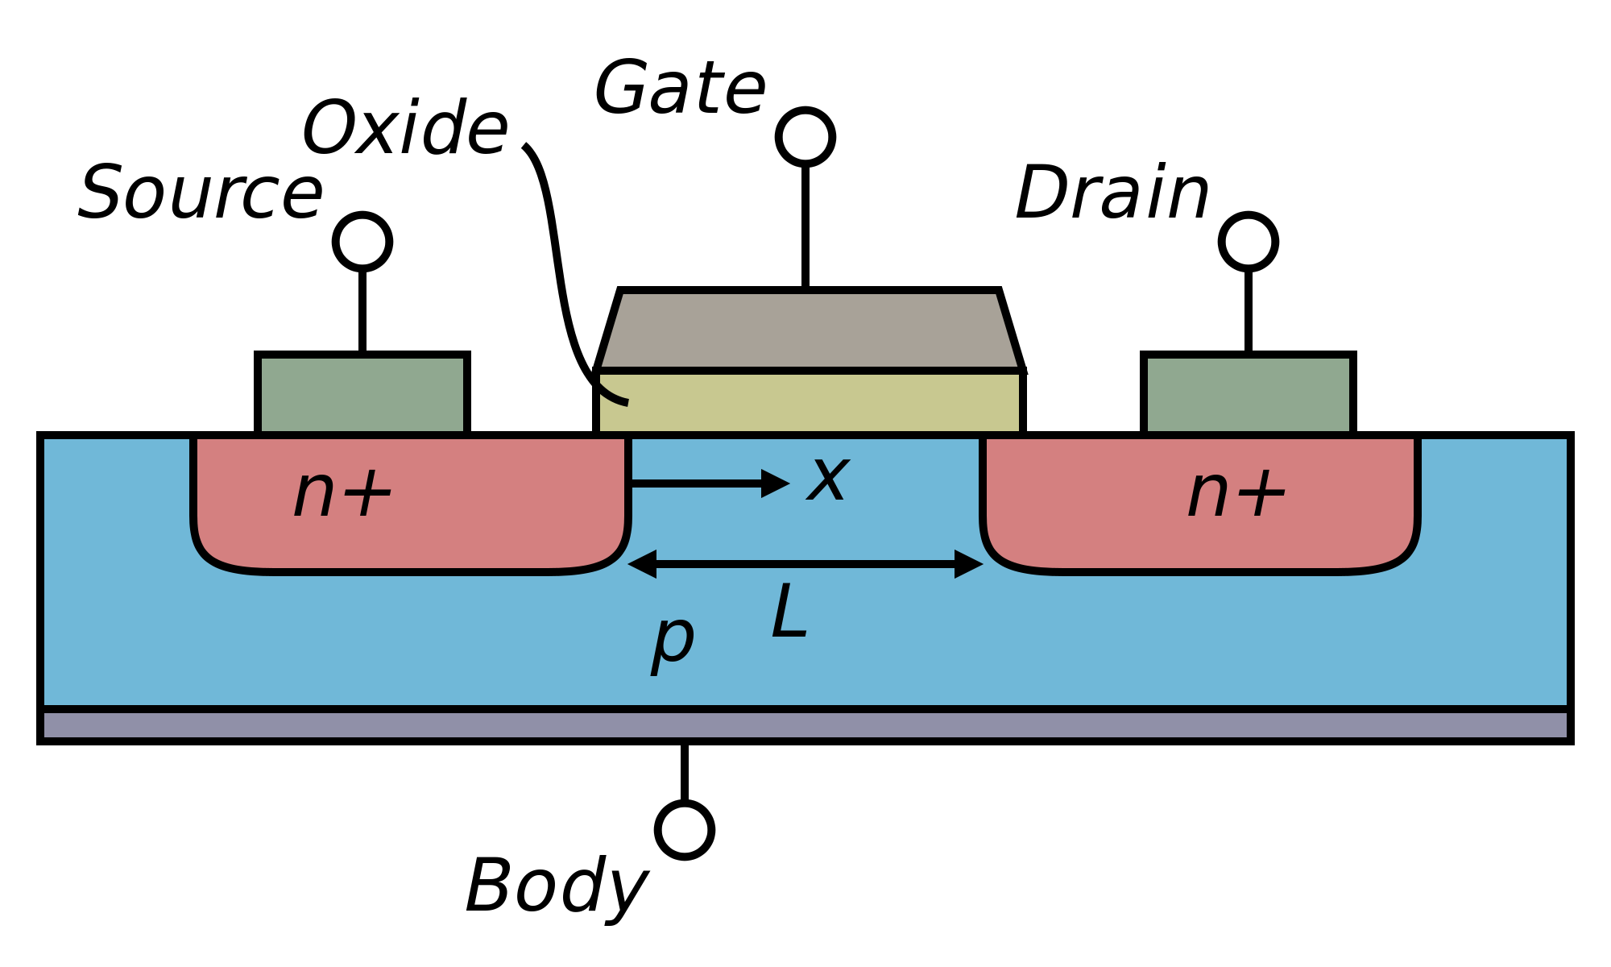
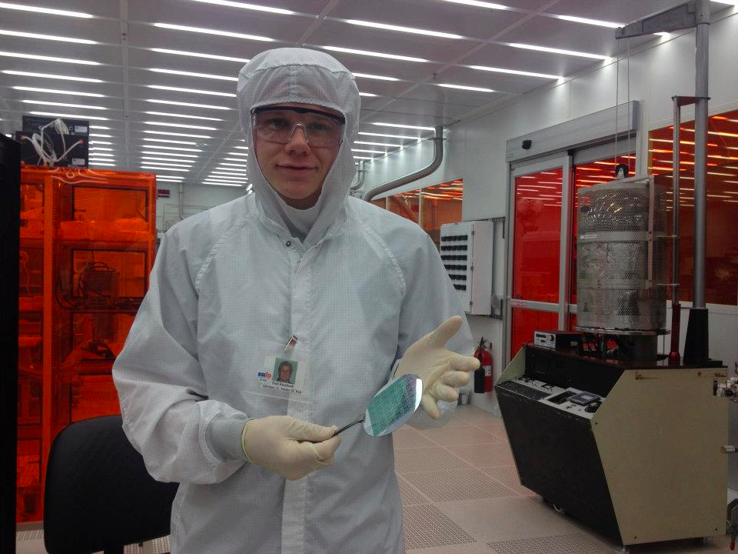

Integrated Circuits (I.C.s)
Solid state transistors can be fabricated en masse on a silicon substrate!
https://en.wikipedia.org/wiki/MOSFET

Slide 8
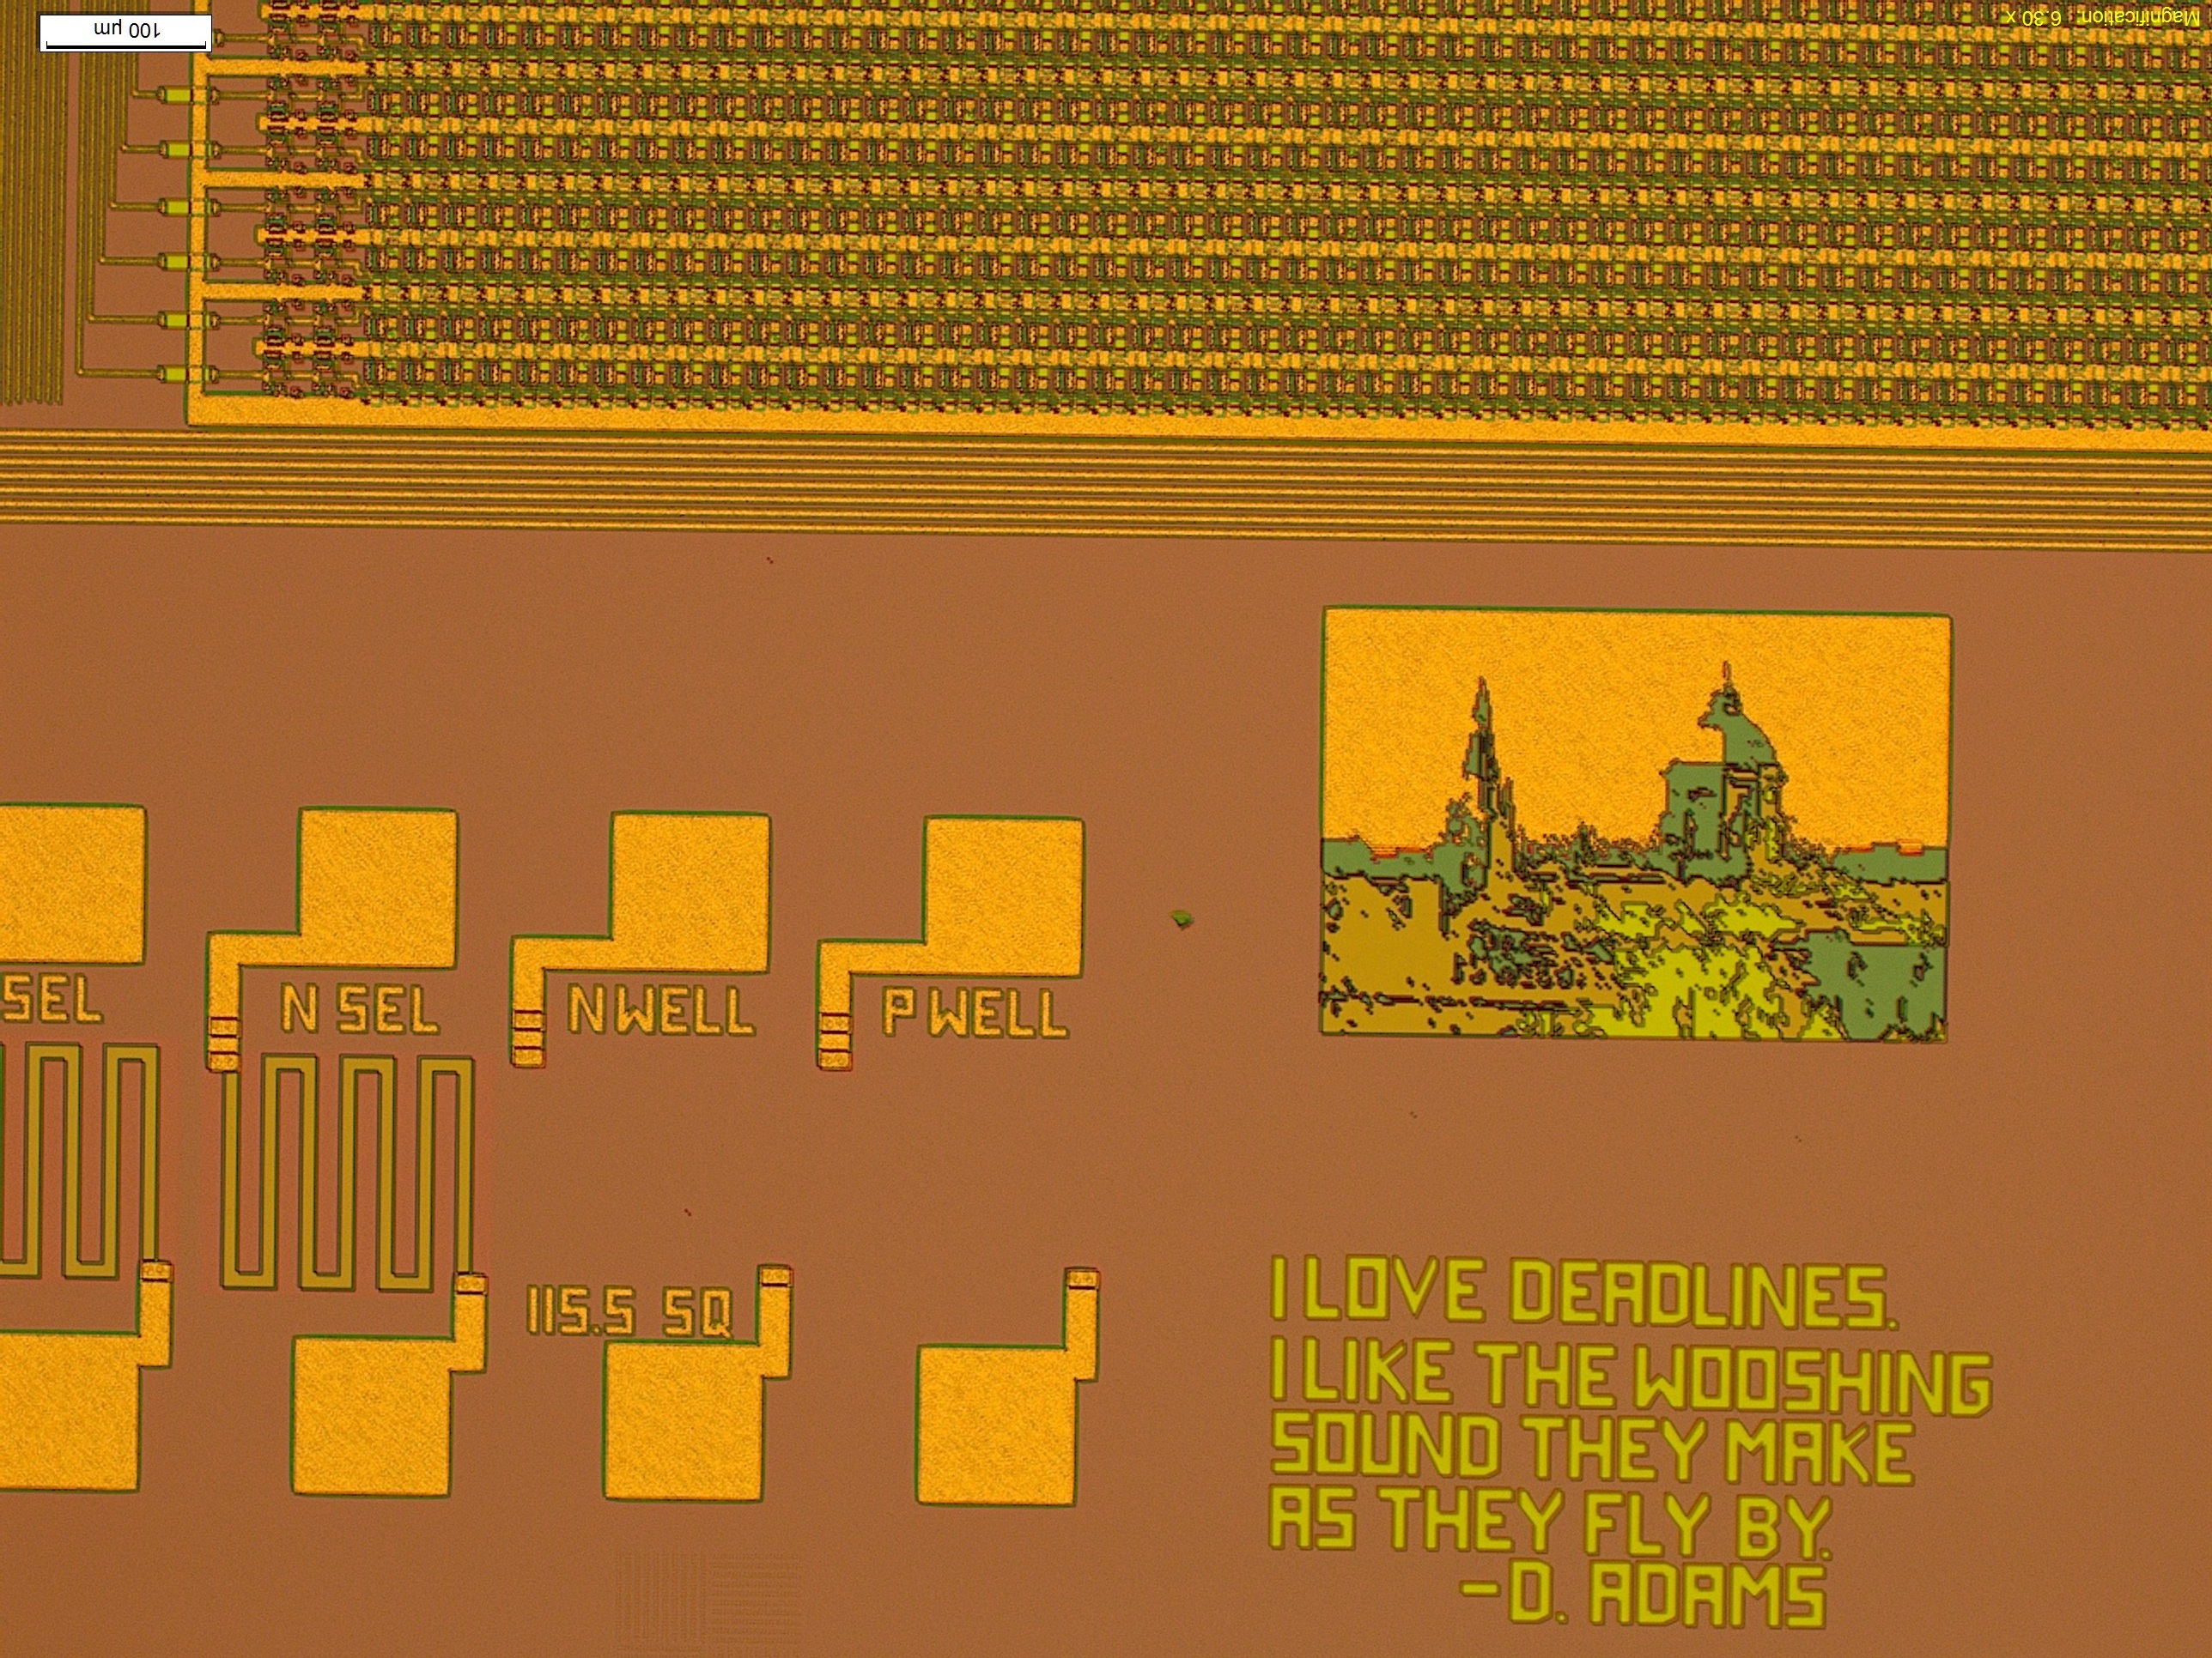
Integrated Circuits (I.C.s)

Slide 9
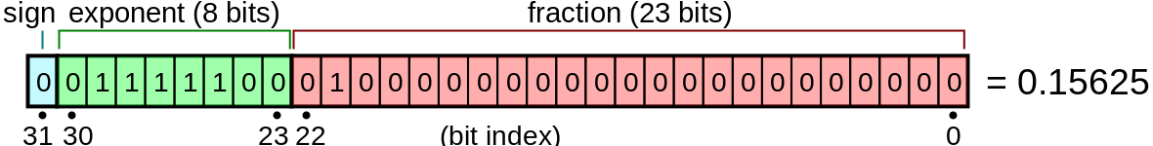
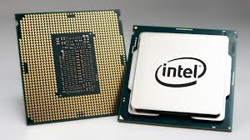
Analog vs. Digital
Digital – A single number is represented by many voltages that form a “binary code”
Analog – A single number is represented by a single voltage.

Slide 10
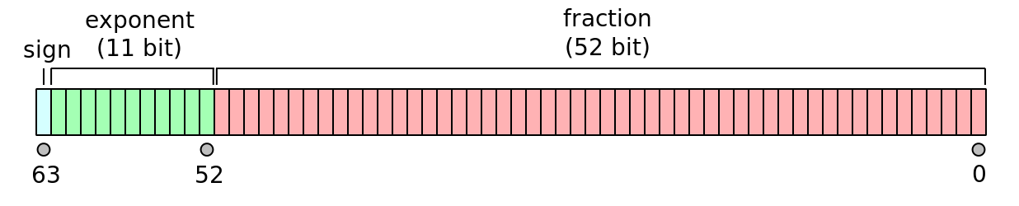
Digital Computers
Digital computers – numbers are represented by several voltages in “binary code”
 | 128 | 64 | 32 | 16 | 8 | 4 | 2 | 1
bit | 0 | 0 | 1 | 1 | 0 | 0 | 1 | 1
voltage | 0V | 0V | 3V | 3V | 0V | 0V | 3V | 3V
51 in 8-bit binary code is 00110011
Single precision floating-point variable – 32 bits or 4 bytes
Double precision floating-point variable – 64 bits or 8 bytes
https://en.wikipedia.org/

Slide 11
Analog-to-Digital Converter
A/D – analog to digital converter (i.e. LabQuest)
Continuous Analog
Discrete Digital
https://nutaq.com
D/A – digital to analog converter (i.e. an iPod)
Discrete Digital
“Continuous” Analog

Slide 12
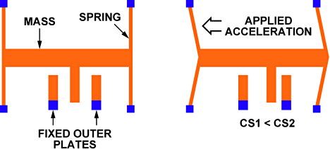
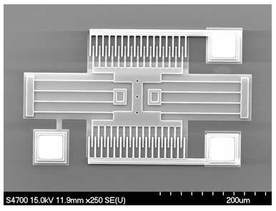
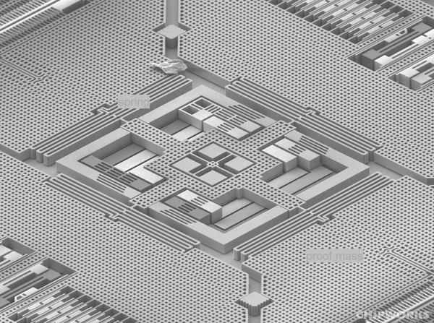
MEMS Accelerometers
Acceleration causes mass to push on spring and displace the “interdigitated” electrodes,
changes electric capacitance.
Micro-Electro-Mechanical Systems (MEMS)

Slide 13
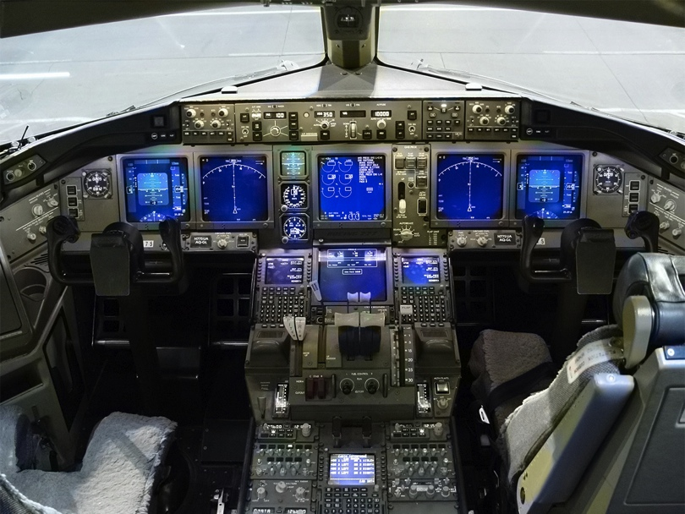
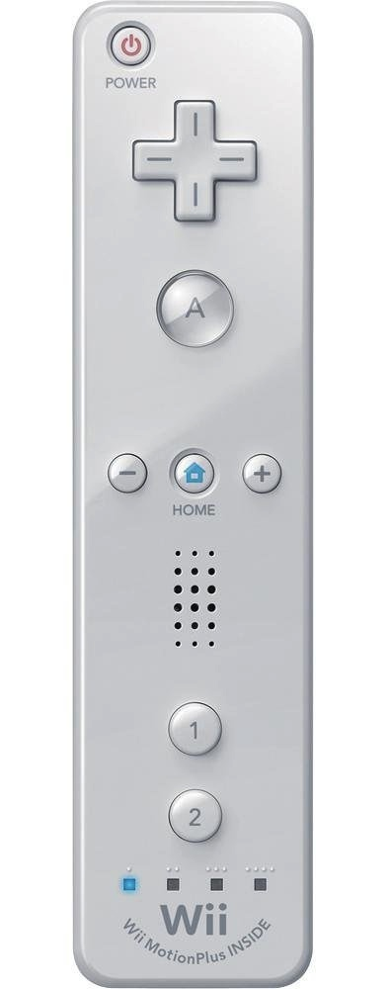

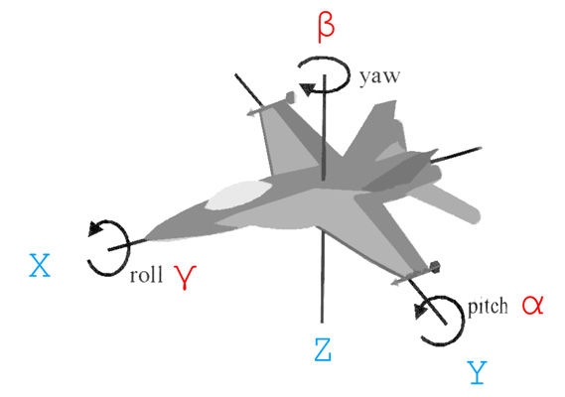
Accelerometers
Boeing 777 glass cockpit.

Slide 14
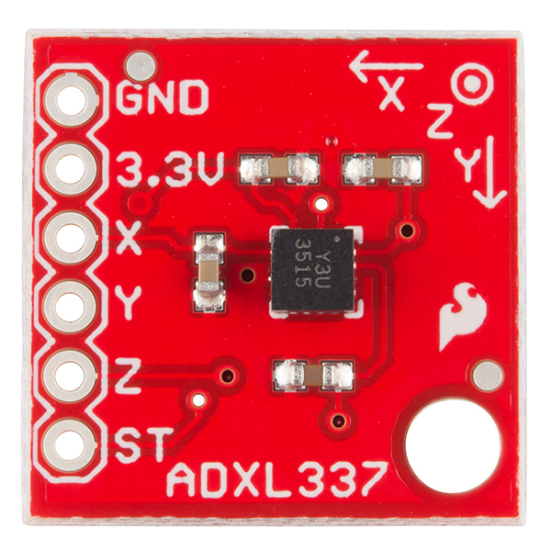
ADXL337 – MEMS Accelerometer
3-axis Accelerometer. Analog sensor outputs voltage linearly related to acceleration.
acceleration
output voltage
-3g (-30 m/s²) ---> 0V
+3g (+30 m/s²) ---> 3V

Slide 15
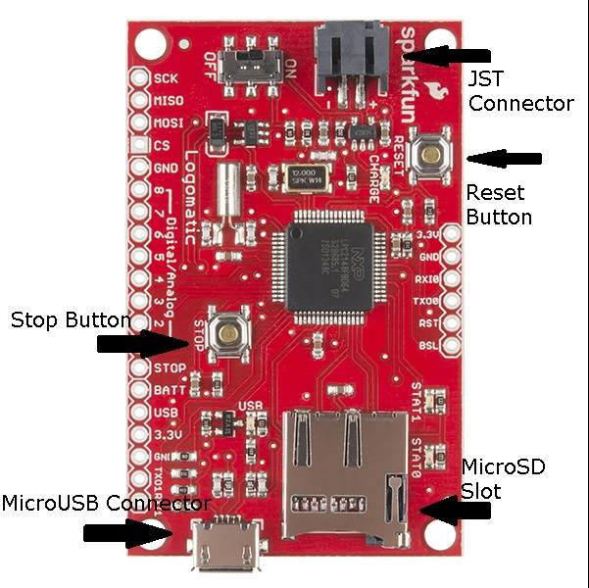
SparkFun Data Logger
10-bit Analog-to-digital converter (A/D). Saves voltages to a MicroSD card.
analog
voltage
10-bit
digital
0V ---> 0
3V ---> 1023

Slide 16
2-point Calibration
2-point calibrations of the system are performed by rotating the sensor about its axes.
a_{y} = +1g (9.8 m/s²)
a_{y} = -1g (-9.8 m/s²)

Slide 17
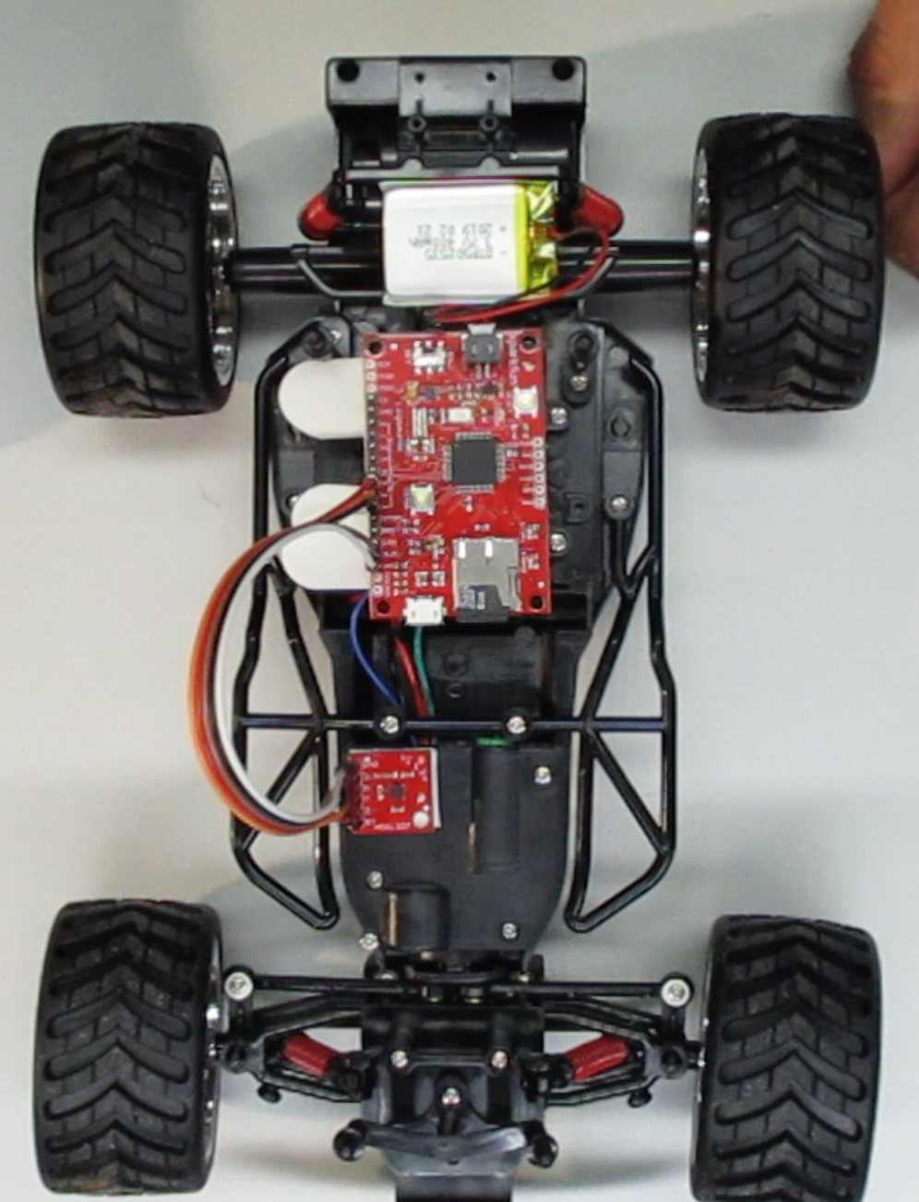
Telemetry of an RC Car
Acceleration data will be recorded at a sampling frequency f_{s} = 50 Hz.
Important: See “Data Processing” section of A9 lab handout.

